Slide 1



Prepared for:
Practicum Defense Committee
Department of Computer Science and Engineering
IUBAT–INTERNATIONAL UNIVERSITY OF BUSINESS AGRICULTURE AND TECHNOLOGY
Founded 1991 by Md. Alimullah Miyan
1991-2026
IntelliGrade
An End-to-End Outcome-Based Examination Management
and Intelligent Script Evaluation Ecosystem
for Higher Education Institutions
Course Code: Practicum CSC 490
Supervised by:
Drs Ferdaus Anam Jibon
Associate Professor
Prepared by:
Md. Taher Bin Omar Hijbullah
22303142
Date: August 31, 2026 | IUBAT, Dhaka, Bangladesh

Slide 2
Contents
03
Table of Contents
Function Point (FP) Calculation
Function Point (FP) Calculation
Table of Contents
Functional Requirements (FR 01-20)
04
Problem Statement & Overview
Problem Statement & Overview
05
Objectives, Scope & Stakeholders
Objectives, Scope & Stakeholders
06
System Architecture Overview
System Architecture Overview
07
21-Module System Catalog
21-Module System Catalog
08
Use Case Diagram
Use Case Diagram
09
Actor Use Case Inventory (27 UCs)
Actor Use Case Inventory (27 UCs)
10
Activity Diagram: AI Pipeline
Activity Diagram: AI Pipeline
11
Activity Diagram: Manual Wizard
Activity Diagram: Manual Wizard
12
Swimlane Diagram (5 Lanes)
Swimlane Diagram (5 Lanes)
13
Sequence Diagram: AI Wizard
Sequence Diagram: AI Wizard
14
Sequence Diagram: Student Portal
Sequence Diagram: Student Portal
15
Class Diagram: Core Domain
Class Diagram: Core Domain
16
Class Diagram: AI Engine
Class Diagram: AI Engine
17
Entity-Relationship Diagram (ERD)
Entity-Relationship Diagram (ERD)
18
Data Flow Diagram: Level 0
Data Flow Diagram: Level 0 (Context)
Data Flow Diagram: Level 1 (System)
Data Flow Diagram: Level 1 (System)
18
37
2

Slide 3

Internship Organization
HOSTING ORGANIZATION
info@alhadiexpress.com.bd | AL Hadi Enterprise | Home
Plot 6 (6th Floor), Road 1/A, Sector 17, Uttara South, Dhaka 1230, Bangladesh.
INTERNSHIP DETAILS
PROJECT DELIVERABLE
Role: Software Engineer Intern
Duration: 01/06/2026 — 20/09/2026
Course: CSC 490
Supervisor: Md. Kawsar Uddin
Senior Soft. Engineer, Al-Hadi Enterprise
IntelliGrade — An End-to-End Outcome-Based
Examination Management and Intelligent Script
Evaluation Ecosystem for Higher Education
Target Institution: IUBAT
Accreditation Standard: BAETE OBE

Slide 4

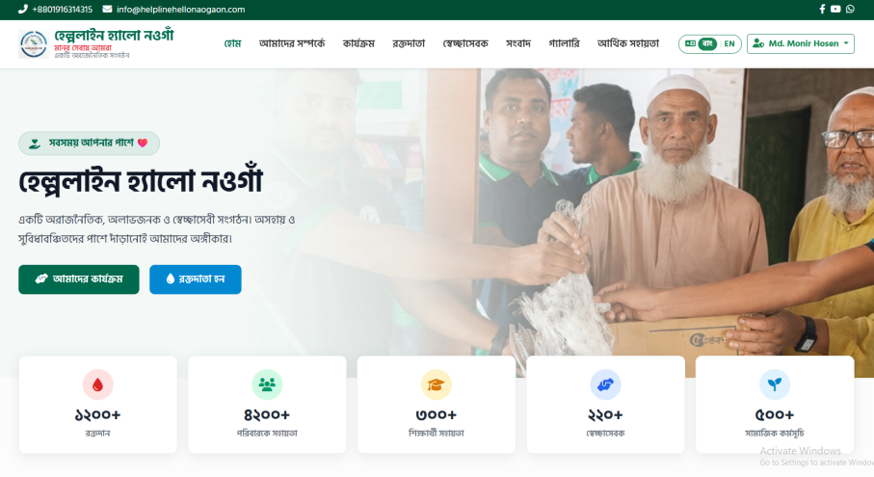
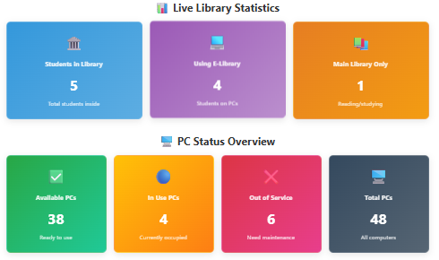
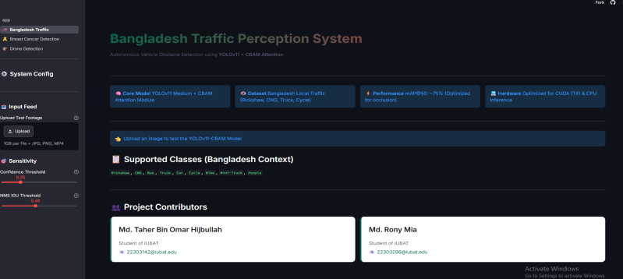
My Portfolio
HijbullahHub
Helpline Hello Naogaon
IUBAT Library Entry/Exit Management System
https://hijbullahml.streamlit.app/

Slide 5
INTRODUCTION

Slide 6
Project Overview & Problem Statement
CURRENT OPERATIONAL CHALLENGES
✗ Labor Fatigue:
Evaluating hundreds of handwritten scripts per semester causes examiner fatigue, drift & delays.
✗ OBE Complexity:
Manual CO1-CO6/PO1-PO12 attainment math is error-prone when done in spreadsheets.
✗ No Student Feedback:
Students receive only a single mark — zero question-level or concept-level insight.
✗ Paper Record Risk:
Physical scripts are lost, damaged, or unavailable during accreditation audits.
✗ Role Fragmentation:
No unified digital ecosystem for Controllers, Heads, Teachers, and Students.
Place Thesis Title Here
6

Slide 7
Project Overview & Problem Statement
INTELLIGRADE INNOVATIVE SOLUTIONS
✓ Dual Wizards:
AI Wizard v3.0 + Direct Manual Grading — teacher always maintains complete grading authority.
✓ OBE:
Automatic CO/PO/KP/CEP/CEA attainment calculation with Bloom taxonomy across questions.
✓ Deep Feedback:
Question-wise marks, strengths, AI comments, criteria breakdown per student.
✓ PDF:
PDF scripts stored securely in institutional media.
✓ 4-Role Portal:
Controller, Dept Head, Teacher & Student — one synchronized ecosystem.

Slide 8
Objectives, Scope & Stakeholders
Specific Objectives
Reduce grading turnaround by 70% via OCR + AI-suggested marks
Implement 23-section IUBAT OBE taxonomy across all exam questions
Provide dual evaluation: AI Wizard v3.0 AND 100% Direct Manual Grading
Deploy split-screen workbench with 1-click mark override & approval
Generate 8-sheet OBE Excel with CO/PO/CQI formulas (openpyxl)
Role portals: Chief Exam Controller, Dept Head, Teacher, Student
Resilient AI failover: Moondream -> Groq -> OpenRouter -> Gemini -> GPT-4o
Institutional SMTP email + PDF attachment dispatch

Slide 9
Objectives, Scope & Stakeholders
Key Stakeholders
Chief Exam Controller
Department Head
Governance, routine scanning, student approvals
OBE auditing, pass-rate analytics, tabulation review
Faculty / Examiner
Student
Q&R authoring, script upload, AI eval, mark override
Grade transparency, PDF downloads, CO/PO feedback

Slide 10
Course & Faculty Allocation
Dispatches automated welcome emails with OTPs, registers department heads, and binds teachers to designated courses.
Governance & Approval Queue
Audits pending student registrations, activates semester exams, and locks finalized tabulations into immutable archives.
Actor Workflow: Chief Exam Controller
AI Exam Routine Ingestion
Uploads complex university examination routine PDFs; system automatically extracts dates, courses, and exam slots via AI/regex hybrid parser.

Slide 11
Faculty Exam Authoring
Builds multi-part exam question papers with 23-field taxonomy mappings (Bloom's, CO, PO, KP, CEP, CEA) and detailed rubrics.
Interactive Evaluation Workbench
Conducts side-by-side verification of scanned scripts against AI scores, overrides criteria marks with audit notes, and finalizes grades.
Actor Workflow: Department Head & Faculty
Department Head Governance
Monitors department-wide grading progress, tracks faculty evaluation bottlenecks, and reviews class OBE attainment heatmaps.

Slide 12
Live Academic Dashboard
Views published semester grades, weighted GPAs (4.00 scale), and exact question-by-question marks breakdown.
Certified PDF Download
Downloads digitally watermarked, officially certified evaluation scripts containing examiner comments and rubric breakdowns.
Actor Workflow: Student Transparency Portal
Secure Self-Registration & OTP
Students self-register with their roll numbers, receive email confirmation, and log in securely via two-factor OTP verification.

Slide 13
Zero Spreadsheet Arithmetic Errors
Real-time automated weighted calculation (CT 10% + Mid 25% + Final 50% + Assign 10% + Att 5%) eliminates human floating-point mistakes.
Human-in-the-Loop Authority
AI provides calibrated suggestions and highlight cues, but teachers retain 100% final grading authority via explicit review modals.
100% Paperless Script Lifecycle
Digital rasterization and certified PDF stamping eliminate script misplacement, physical transport logistics, and paper degradation.
System Benefits: Operational Efficiency & Accuracy
70% Grading Turnaround Reduction
Automated 300 DPI script slicing, multi-engine OCR, and parallel AI rubric grading cut per-script turnaround from 25 minutes to under 7 minutes.

Slide 14
One-Click 8-Sheet Excel Tabulation
Generates complete institutional Excel workbooks ready for immediate submission to the Academic Council and accreditation teams.
Tamper-Proof Audit Trails
Every mark override, teacher review, and finalization action is permanently recorded with actor ID, timestamp, and rationale.
Democratized Student Transparency
Eliminates student grading anxiety by offering full visibility into marking criteria, deduction reasons, and performance feedback.
System Benefits: OBE Compliance & Accreditation
Automated BAETE CO/PO Attainment
Translates raw question marks directly into Course Outcome (CO1-CO6) and Program Outcome (PO1-PO12) attainment percentages.

Slide 15
Sprint 2: Academic Governance & Routine Parser
Exam schedule PDF parser, course allocations, and 23-taxonomy question and rubric authoring studio.
Sprint 3: Document Ingestion & Hybrid OCR
300 DPI rasterization, OpenCV deskewing, PyMuPDF native vector text, and EasyOCR handwriting recognition.
Sprint 4: Multi-Provider AI Failover Engine
Orchestrator integration with Moondream2 (local), Groq Llama-3.3 70B, Gemini 2.5 Flash, and OpenAI GPT-4o.
Sprint 5: Evaluation Workbench & Finalization
Split-screen grading UI, manual fallback wizard, ReportLab certified PDF stamping, and storage artifact purging.
Sprint 6: OBE Tabulation & Final Audits
Live CO/PO attainment matrix, 8-sheet openpyxl Excel exporter, async SMTP notifications, and E2E system testing.
Software Development Methodology: Agile Scrum
Sprint 1: Foundation & RBAC
Role-based authentication, user profile schema, OTP email verification, and baseline portal layouts.

Slide 16
Department Head Requirements
Must track department faculty evaluation deadlines, inspect course pass rates, and verify OBE attainment standards.
Course Examiner Requirements
Must upload answer scripts in bulk, map answers to questions, review AI mark distributions, override grades, and export tabulations.
Student Requirements
Must access personal grades in real-time, view question-level feedback, and download signed, watermarked answer scripts.
User Requirements: Functional Needs by Actor
Chief Exam Controller Requirements
Must schedule exams from raw PDFs, manage academic roles, audit system-wide grading health, and approve student rosters.

Slide 17
Functional Requirements (FR-01 to FR-20)
37 Functional Requirements derived from system use cases
FR-01
[Auth] Unified role-based authentication -> role-specific dashboard redirect
FR-11
[Q&R] 23-section IUBAT OBE metadata per question: Bloom, CO, PO, KP, CEP, CEA
FR-02
[Auth] Student self-registration with is_approved=False -> Controller approval required
FR-12
[Q&R] Structured rubrics with criteria, ideal answer, partial marks, keywords
FR-03
[Auth] 6-digit OTP password reset via SMTP with 10-minute expiry window
FR-13
[Q&R] Extract bounding boxes for Question Figures, Tables, LaTeX formulas
FR-04
[Gov] Exam Controllers manage Colleges, Schools, Departments, Courses, Faculty
FR-14
[Q&R] Sanitize unescaped LaTeX backslashes to prevent JSON decode errors
FR-05
[Gov] Toggle active/blocked status for any institutional user account
FR-15
[OCR] Teacher uploads master solution; system links steps to questions
FR-06
[AI] Parse multi-page exam routine PDFs -> extract dates, times, course codes
FR-16
[OCR] PDF scripts rendered at 300 DPI + OpenCV deskew + noise reduction
FR-07
[AI] 0ms local DB course match -> 1-click batch examination creation
FR-17
[OCR] Versioned working copies in submission_working/ with increment IDs
FR-08
[AI] Admin configures API keys: Gemini, Groq, OpenAI, OpenRouter, Ollama
FR-18
[OCR] Hybrid OCR: PyMuPDF -> PyTesseract -> EasyOCR PyTorch CPU fallback
FR-09
[Head] Live departmental pass rates + active courses + enrolled students dashboard
FR-19
[Map] Detect Q-number headings using strict start-of-line regex state machine
FR-10
[Head] Dept Heads audit course OBE sheets and CO/PO attainment matrices
FR-20
[Map] Interactive mapping modal: teacher adjusts page numbers and crop regions
Slide 21/37

Slide 18
Functional Requirements (FR-21 to FR-37)
FR-21
[AI] Failover chain: Local Vision -> Groq -> OpenRouter -> Gemini -> OpenAI
FR-22
[AI] Track HTTP 429 events -> exponential backoff cooldowns per provider
FR-23
[AI] Enforce 45-second timeout per AI request -> immediate failover trigger
FR-24
[AI] Evaluate against rubric criteria -> return marks, confidence, strengths, mistakes
FR-25
[AI] Set requires_manual_review=True when confidence < configured threshold (0.75)
FR-26
[WB] Split-screen workbench: scanned script image left, AI score + rubric right
FR-27
[WB] Teacher mark override -> logged in TeacherReview + EvaluationHistory tables
FR-28
[PDF] Stamp certified PDF: institutional header, marks, comments, digital watermark
FR-29
[Tab] Aggregate: Class Test (10%), Midterm (25%), Final (50%), Assign (10%), Att (5%)
FR-30
[Tab] Real-time sync: tabulation modal edits -> StudentGradeRecord + Excel + Dashboard
FR-31
[Tab] Generate 8-sheet Excel (openpyxl): HOME, CO_ATTAINMENT, PO, CQI formulas
FR-32
[Email] Non-blocking SMTP via dsr.iubat.ac.bd for results, credentials, OTPs
FR-33
[Std] Student dashboard: GPA (4.00 scale), question-wise scores + PDF download links
FR-34
[Wiz] Dual wizards: AI Wizard v3.0 + Manual Grading Wizard (zero AI/OCR path)
FR-35
[Stor] Auto-purge working images from media/submission_working/ upon PDF creation
FR-36
[DB] Composite indexes + select_related/prefetch_related -> eliminate N+1 queries
FR-37
[AI] Local vision: 800px LANCZOS downsampling + JPEG quality=75 before Ollama
Slide 22/37

Slide 19
Non-Functional Requirements
NFR-01
Performance
Dashboard pages rendered <= 1.5 seconds under institutional network load
NFR-02
Performance
300 DPI render + PyTesseract OCR per page <= 4.0 seconds
NFR-03
Performance
AI evaluation per question via Groq/Gemini <= 8.0 seconds
NFR-04
Failover
Provider timeout/429 -> failover transition <= 500 milliseconds
NFR-05
Scalability
Concurrent batch upload of 100 multi-page scripts without deadlock
NFR-06
Availability
>= 99.5% uptime during exam periods via offline vision fallback
NFR-07
Security
Passwords salted+hashed (Argon2/PBKDF2-SHA256), never plaintext stored
NFR-08
Security
Every view/API endpoint enforces @role_required RBAC decorators
NFR-09
Security
All POST/PUT/DELETE requests mandate valid CSRF tokens from middleware
NFR-10
Integrity
Grade updates execute within atomic DB transactions (transaction.atomic)
NFR-11
Audit
Mark overrides log immutable audit entries with teacher ID + timestamp
NFR-12
OBE
CO/PO calculations strictly adhere to IUBAT & BAETE accreditation standards
NFR-13
Excel
8-sheet workbooks preserve openpyxl formulas, validation, and cell colors
NFR-14
Email
SMTP dispatches run in background threads — never blocks HTTP responses
NFR-15
Usability
Responsive UI with dark/light theme + split-screen PDF viewer on desktop
NFR-16
DB
Composite B-tree indexes + eager-loading for near-O(1) query complexity
NFR-17
Storage
Draft working images purged upon finalization to conserve disk space
Slide 23/37

Slide 20
System Architecture Overview
RBAC Auth
Controller Portal
Dept Head
Administration & Portals
Teacher Portal
Student Portal
Structure CRUD
AI Routine Parser
23-OBE Studio
Academic Ingestion
Master Solution
300 DPI Preproc
PyMuPDF
PyTesseract
OCR / Preprocessing
EasyOCR CPU

Slide 21
System Architecture Overview
AI Wizard
Manual Wizard
LLM Failover
Dual Evaluation Engine
Cooldown Tracker
Split-Screen WB
PDF
OBE Tabulation
Tabulation & Output
8-Sheet Excel
Email

Slide 22
21-Module Architecture Catalog
Service-oriented modular decomposition of IntelliGrade
MOD-01
MOD-02
MOD-03
MOD-04
MOD-05
Auth & RBAC
Controller Portal
Dept Head Portal
Teacher Workspace
Student Portal
MOD-06
MOD-07
MOD-08
MOD-09
MOD-10
Acad. Structure
AI Routine Parser
23-Taxonomy Studio
Master Solution
300 DPI Preproc
MOD-11
MOD-12
MOD-13
MOD-14
MOD-15
Hybrid OCR Engine
Boundary & Mapping
AI Eval Wizard v3
Manual Grading Wiz
LLM Failover Chain
MOD-16
MOD-17
MOD-18
MOD-19
MOD-20
TaskRouter & Health
Split-Screen WB
PDF Generate
OBE Tabulation
8-Sheet Excel Sync
Email Service

Slide 23
Use Case Diagram
Figure 1: IntelliGrade Use Case Diagram — 4 Actors (Chief Exam Controller, Dept Head, Faculty/Examiner, Student) interacting across 27 documented use cases

Slide 24
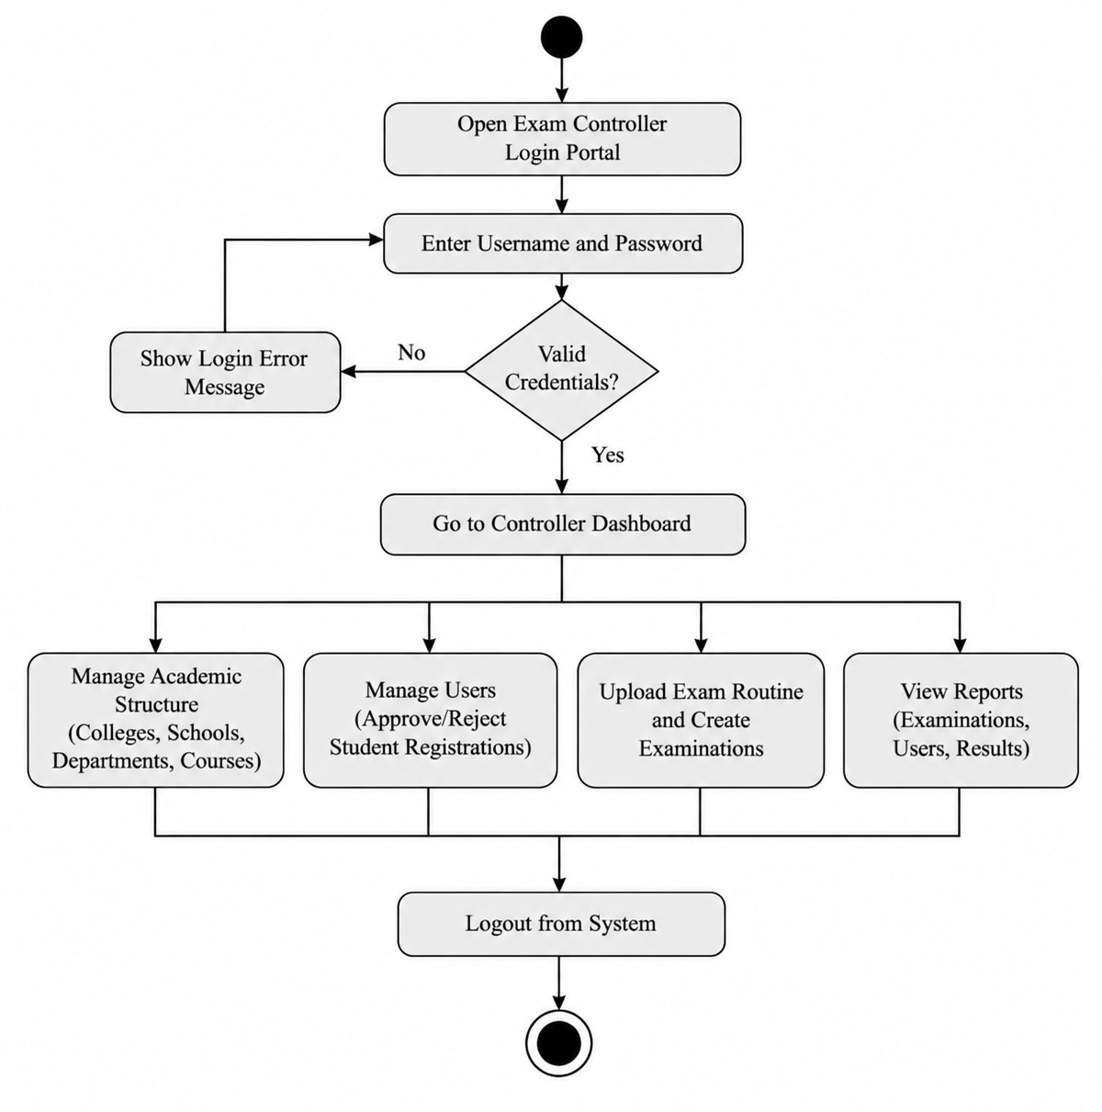
Activity Diagram: Routine Scanning & Ingestion

Slide 25
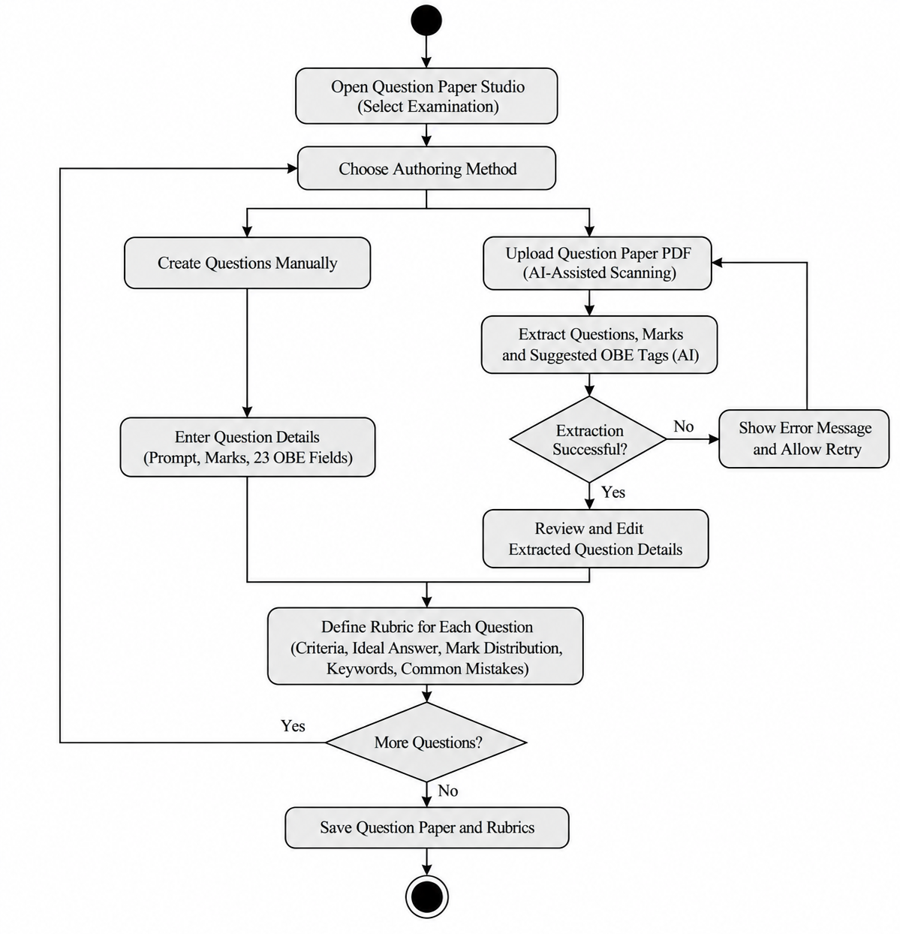
Activity Diagram: Question Paper & Rubric Authoring

Slide 26
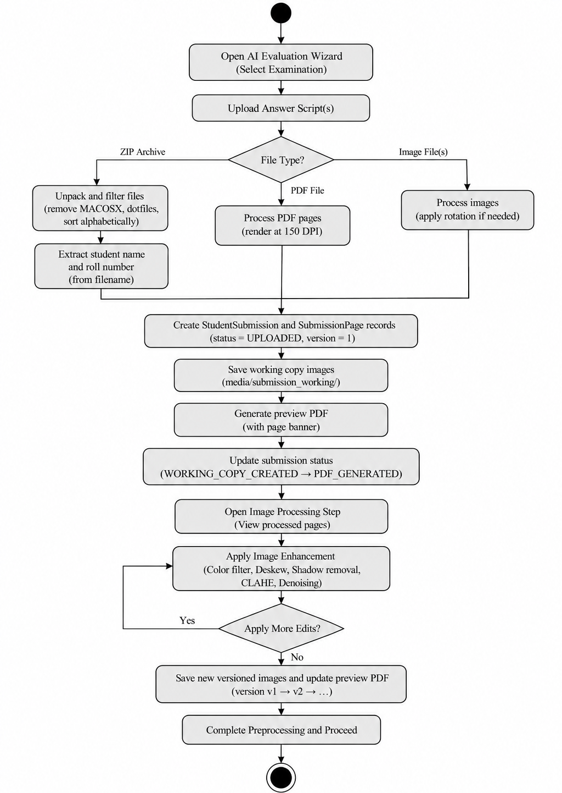
Activity Diagram: Script Ingestion & 300 DPI Preprocessing

Slide 27
Activity Diagram — AI Evaluation Wizard Pipeline
Figure 2: Activity Diagram — AI Evaluation Wizard v3.0 Pipeline (Script Upload → 300 DPI Preprocessing → Hybrid OCR → Boundary Detection → AI Failover Evaluation → Workbench)
Slide 9/37

Slide 28
Activity Diagram — Manual Grading Wizard
Figure 3: Activity Diagram — Manual Grading Wizard (Fast PDF Page Slicing Only — Zero AI/OCR overhead; Direct teacher page-to-question assignment)
Slide 10/37

Slide 29
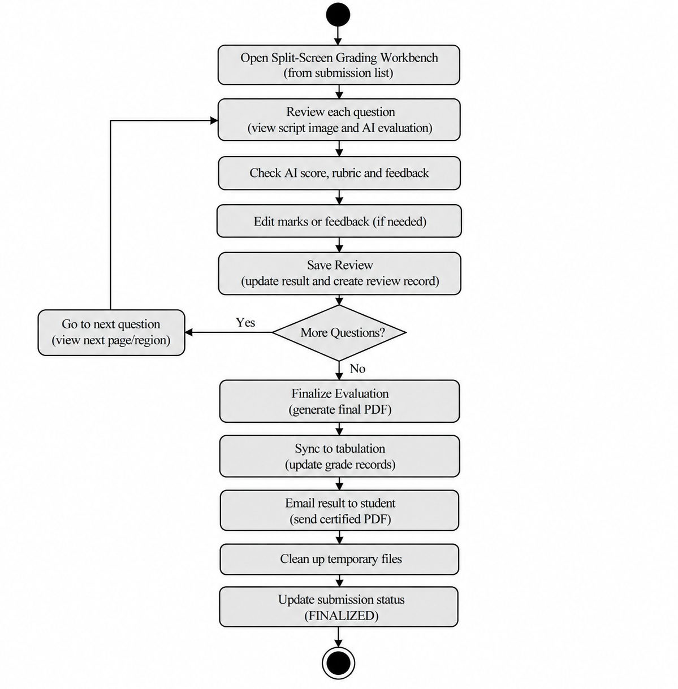
Activity Diagram: Teacher Review & Finalization

Slide 30
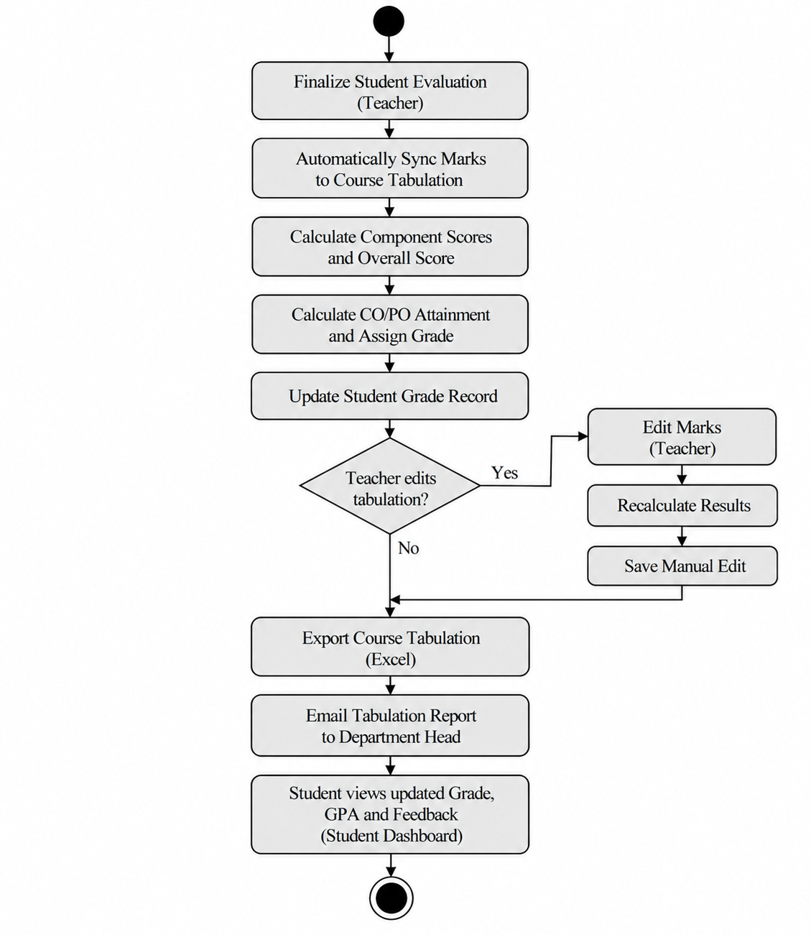
Activity Diagram: OBE Tabulation & Email Dissemination

Slide 31
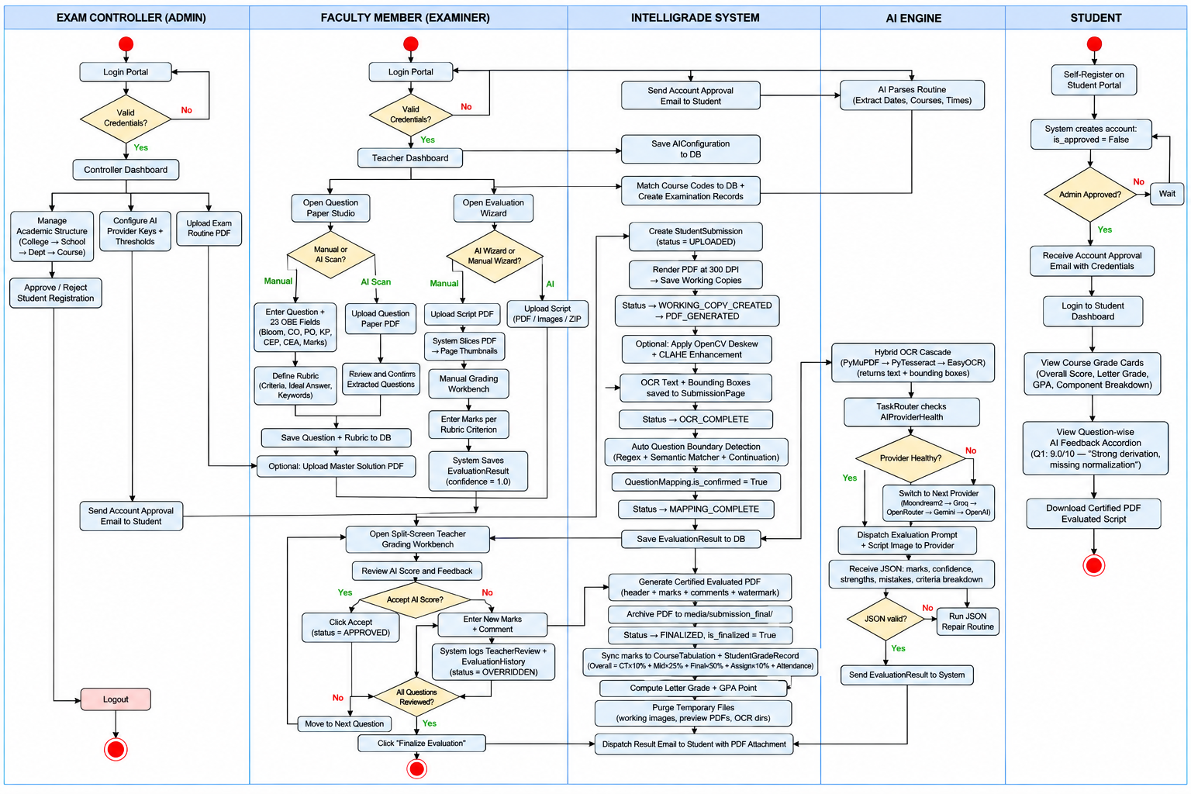
Swim-lane Diagram: End-to-End Evaluation Ecosystem

Slide 32
Sequence Diagram — AI Evaluation Wizard
Teacher
Browser
Django
Views
Script
Processor
OCR
Engine
AI Orchestrator
Groq/Gemini
LLM
Database
POST upload_student_submission()
process_submission() -> 300 DPI render
run_ocr() -> PyMuPDF -> Tesseract -> EasyOCR
BBoxes + text blocks returned
detect_boundaries() -> QuestionMapping created
Return mapping UI / confirmation
POST confirm_mapping() -> trigger AI eval
route_evaluation_task(question_mappings)
POST evaluate(rubric, image, master_sol)
JSON{score, confidence, strengths, mistakes}
save EvaluationResult + flag if conf < 0.75
ACK -> all questions evaluated
Redirect -> evaluation_workspace
Figure 4: Sequence Diagram — AI Evaluation Wizard (7 Lifelines: Teacher Browser → Django Views → Script Processor → OCR Engine → AI Orchestrator → Groq/Gemini LLM → Database)
Slide 12/37

Slide 33
Sequence Diagram — Student Portal & Result Publication
Student
Browser
Django
Views
Database
Email
Service
PDF
Generator
POST student_login(username, password)
authenticate() verify Profile.role=STUDENT
Session token + profile data
Redirect -> /dashboard/student/
GET dashboard_student()
fetch StudentGradeRecord + EvaluationResult
Grade records, CO/PO attainments, GPA
Render student dashboard with cards
GET download_certified_pdf(submission_id)
generate_pdf() if finalized=True
Watermarked PDF binary
send_result_email(student, pdf_attachment)
SMTP ACK
Figure 5: Sequence Diagram — Student Result Publication (Student Browser → Django Views → Database → PDF Generator → Email Service; ends with certified PDF dispatch)
HTTP 200: PDF download response
Slide 13/37

Slide 34
Class Diagram — Core Domain Model
Key entity classes, attributes, and associations in core/models.py
«class» Profile
«class» Examination
«class» Question
- user: FK(User)
- role: Enum[ADMIN|TEACHER|DEPT_HEAD|STUDENT]
- department: FK(Department)
- is_approved: bool
- title, course: FK(Course)
- exam_date, start_time, end_time
- assigned_teachers: M2M
- master_solution_parsed
- exam: FK(Examination)
- prompt_text, marks
- bloom_level, co, po, kp, cep, cea
- rubric: FK(Rubric)
+ get_role_label()
+ get_absolute_url()
+ get_full_taxonomy()
«class» StudentSubmission
«class» QuestionMapping
«class» EvaluationResult
- examination: FK(Examination)
- student_roll_no, status
- is_finalized: bool
- certified_pdf_path
- submission: FK(StudentSubmission)
- question: FK(Question)
- page_numbers: JSON
- mapping_status, is_confirmed
- mapping: FK(QuestionMapping)
- obtained_marks, max_marks
- confidence_score, status
- requires_manual_review: bool
+ can_finalize()
+ get_answer_pages()
+ get_percentage()
«class» StudentGradeRecord
«class» CourseTabulation
- tabulation: FK(CourseTabulation)
- student: FK(Profile)
- ct_marks, mid_marks, final_marks
- overall_score, grade_point
- examination: FK(Examination)
- is_published: bool
- excel_file_path
+ compute_weighted_score()
+ compute_co_attainment()
Slide 14/37

Slide 35
Class Diagram — AI Engine & Services
«class» AIEvaluationOrchestrator
«class» BaseProvider
«class» LocalOfflineVisionProvider
- provider_chain: list[BaseProvider]
- health_tracker: ProviderHealthTracker
- timeout_budget: int = 45
- api_key: str
- model_name: str
- max_retries: int
- ollama_endpoint: str
- max_image_size: int = 800
- jpeg_quality: int = 75
+ route_task(mapping)
+ failover_to_next()
+ evaluate(prompt, image) -> JSON
+ is_healthy() -> bool
+ resize_lanczos(img)
+ encode_base64(img)
«class» GroqProvider
«class» ProviderHealthTracker
«class» TabulationService
- model: str = 'llama-3.3-70b'
- tpm_limit: int
- cooldowns: dict[str, datetime]
- failure_counts: dict
- ct_weight=0.10, mid=0.25, final=0.50
- assign=0.10, attendance=0.05
+ post_completion(msgs)
+ handle_429()
+ mark_failed(provider)
+ is_on_cooldown(provider)
+ sync_submission(sub)
+ compute_grade_point(score)
«class» FinalizationService
«class» EmailService
- pdf_generator: EvaluatedPDFService
- working_dir: Path
- smtp_host, smtp_port
- sender: str
+ finalize_submission(sub)
+ purge_artifacts()
+ dispatch_result(student, pdf)
+ send_otp(email, otp)
Slide 15/37

Slide 36
Entity-Relationship Diagram (ERD)
Figure 6: Entity-Relationship Diagram — IntelliGrade Core Domain Model (20+ entities, 28 applied migrations; key relations: Course→Examination→Question→StudentSubmission→EvaluationResult→StudentGradeRecord)

Slide 37
Data Flow Diagram — Level 0 (Context Diagram)
Figure 7: Data Flow Diagram — Level 0 Context Diagram (4 external entities: Controller, Faculty, Student, AI Providers; 1 central IntelliGrade system process)
Slide 17/37

Slide 38
Data Flow Diagram — Level 1 (System Level)
Figure 8: Data Flow Diagram — Level 1 System Decomposition (21 functional sub-processes: Auth → Academic Ingestion → OCR → Dual Evaluation → Tabulation → Email)
Slide 18/37

Slide 39
Computational: Floating-Point Rounding Inconsistencies
Python standard float math drifting by +-0.01 between web UI display and exported Excel workbooks.
Accuracy: Handwriting OCR Recognition Variance
Messy, cursive, or low-contrast handwritten answer scripts yielding low OCR confidence scores.
Operational: Server Storage Exhaustion
Uncompressed high-resolution 300 DPI raw page images rapidly filling local server disk partitions.
Governance: Unauthorized Grade Modifications
Compromised faculty sessions or malicious POST requests attempting to alter finalized examination marks.
Risk Management: Identification (RMMM Framework)
Technical: AI API Rate Limits & Network Outages
Groq / Gemini HTTP 429 throttling or campus internet dropouts stalling the script grading pipeline.

Slide 40
Strict Decimal Wrapping & Excel Formula Verification
All intermediate scores wrapped in round(val, 2). openpyxl formulas validate Python-computed totals on export.
Adaptive Contrast & Human Review Queue
OpenCV CLAHE enhancement + thresholding. Any question confidence < 0.75 is flagged for mandatory teacher review.
Automated Working Copy Artifact Purging
Post-finalization cleanup script deletes interim draft images while keeping certified PDFs and compressed records.
Immutable Audit Logs & Session Expiry
EvaluationAuditLog stores every mark change with actor ID, IP, and reason. Automatic session timeouts protect active portals.
Risk Management: Mitigation Strategies & Safeguards
Dynamic Multi-Provider AI Failover
TaskRouter cascades from Groq -> OpenRouter -> Gemini -> OpenAI -> Local Moondream2 (Ollama) with 45s timeout budgets.

Slide 41
Function Point (FP) Calculation
IFPUG Method — Quantifying IntelliGrade system size from functional requirements
IFPUG FP Analysis — IntelliGrade
Component Type
Count
Complexity
Weight
FP Contribution
External Inputs (EI) — 27 Use Case workflows
27
Average
4
108
External Outputs (EO) — PDF, Excel, Email, Dashboard
18
Average
5
90
External Inquiries (EQ) — Grade views, downloads
12
Simple
3
36
Internal Logical Files (ILF) — 21+ Django models
21
Complex
10
210
External Interface Files (EIF) — 5 AI providers/SMTP
5
Average
7
35
Total Unadjusted FPs (UFP)
479
Value Adjustment Factor (VAF) = 0.65 + (0.01 × Sum-GSCs)
Sum-GSCs (14 General System Characteristics) = 47 → VAF = 0.65 + 0.47 = 1.12
Adjusted Function Points (AFP) = UFP × VAF = 479 × 1.12 = 536.48 FPs
EI: 27 UC workflows | EO: Certified PDF, Excel, Email, Dashboards | ILF: All 21+ Django models | EIF: Gemini, Groq, Ollama, OpenRouter, SMTP
Slide 20/37

Slide 42
External Outputs (EO) — 7 Transactions
Certified PDF Generation, 8-Sheet Excel Export, Student Dashboard, Grade Cards, OCR Visualizer, Email Alert Dispatch.
External Interface Files (EIF) — 3 Interfaces
Multi-Provider AI Orchestration (Groq/Gemini/OpenAI), SMTP Gateway, Local Ollama Moondream2 Service.
Internal Logical Files (ILF) — 5 Data Groups
Core Profiles/Auth, Exam & Question Hierarchy, Student Submissions & Pages, Evaluation Results, Tabulation & Grade Records.
Technical Difficulty Index (TDI) & VAF
14 General System Characteristics evaluated -> TDI = 40 -> Value Adjustment Factor (VAF) = 1.05. AFP = 130 * 1.05 = 136.5 AFP.
Function Point Analysis: Complexity Breakdown
External Inputs (EI) — 6 Transactions
Routine Scanning, Script Preprocessing, Question Authoring, Mark Override, Student Self-Registration, Attendance Edit.

Slide 43
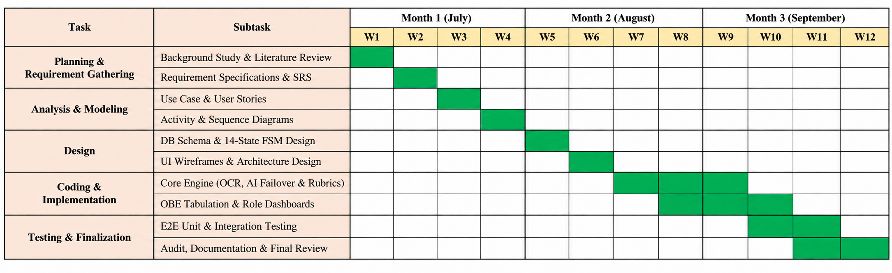
Project Scheduling: 12-Week Gantt Chart

Slide 44
Total Project Cost Estimation Summary (BDT)
Cost Component | Particulars & Resource Allocation | Amount (BDT)
Personnel Salary | System Architect / Full-Stack Developer (8 Months @ 80,000) | 640,000
Personnel Salary | AI / Machine Learning Engineer (6 Months @ 75,000) | 450,000
Personnel Salary | Database Engineer (4 Months @ 60,000) | 240,000
Personnel Salary | UI/UX Front-End Designer (4 Months @ 50,000) | 200,000
Personnel Salary | QA / Test Engineer (3 Months @ 45,000) | 135,000
Subtotal Personnel | 5 Software Engineering Specialists (Total 25 Person-Months) | 1,665,000
Hardware Costs | Dev Workstation (Core i7, 32GB RAM, 1TB SSD) + RTX 4060 GPU | 185,000
Hardware Costs | Network Switches, High-Speed Router, UPS Backup Equipment | 25,000
Subtotal Hardware | Dedicated Development & On-Premises Inference Hardware | 210,000
Software & Cloud | Django, PostgreSQL, PyMuPDF, EasyOCR (Open Source) | 0
Software & Cloud | Production Cloud Server Hosting & Custom Domain Name | 8,220
Operational Expenses | Electricity, High-Speed Internet, Testing Stationery & Supplies | 80,000
GRAND TOTAL | Comprehensive End-to-End System Development Cost | 1,963,220 BDT

Slide 45
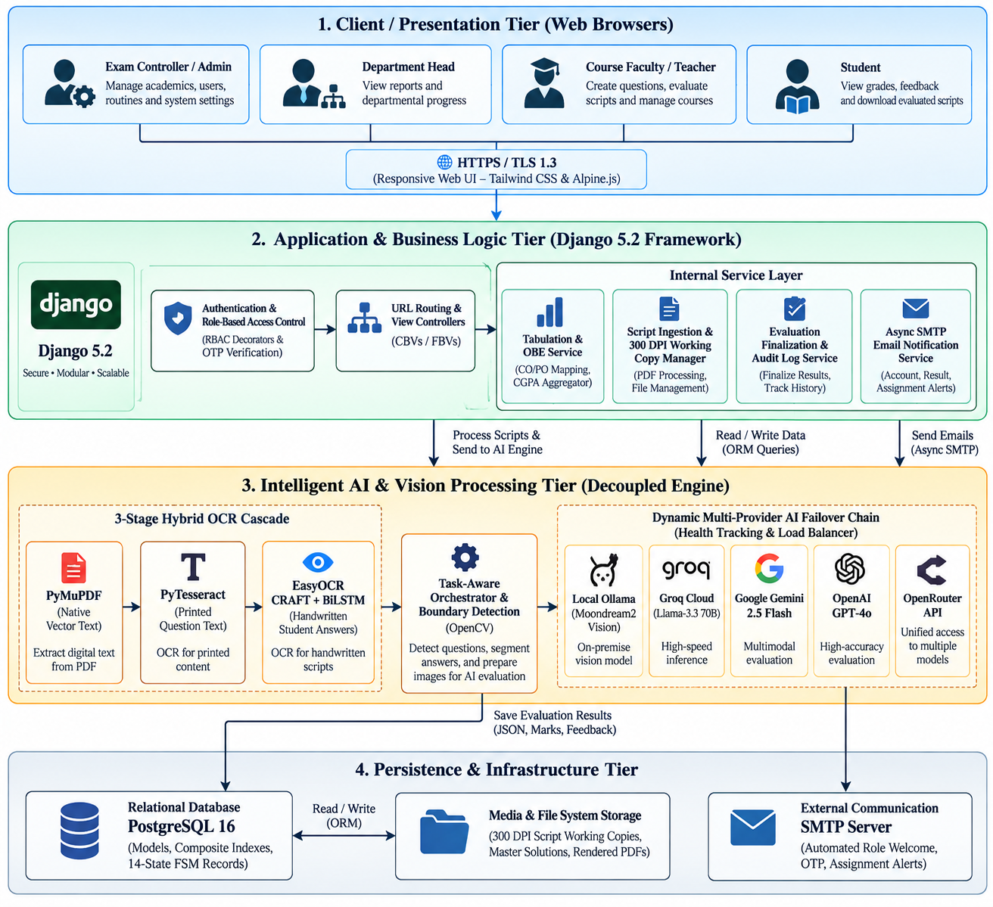
System Architecture Overview Diagram (4 Tiers)

Slide 46
Technology Stack & Infrastructure
Full technology choices: backend, AI, OCR, database, and UI layers
Backend Framework
Database Layer
AI & LLM Providers
• Django 5.2.x (Python 3.11)
• SQLite (dev) -> PostgreSQL (prod)
• Google Gemini 2.5 Flash / 2.0 Flash
• Class-based + function-based views
• 28 Django migrations applied
• Groq Llama-3.3-70B Versatile
• CSRF, RBAC, Session Auth
• Composite B-tree indexes
• OpenRouter API Gateway
• Atomic DB transactions
• select_related / prefetch_related
• OpenAI GPT-4o (backup)
• Ollama Moondream2 (offline)
OCR & Vision
Frontend / UI
Output & Reports
• PyMuPDF (font-map extraction)
• TailwindCSS CDN
• openpyxl — 8-sheet OBE Excel
• PyTesseract (printed text)
• Lucide Icons
• ReportLab — certified PDF stamps
• EasyOCR PyTorch CPU (handwritten)
• Plus Jakarta Sans (Google Fonts)
• Async SMTP email (threading)
• OpenCV deskew / noise filter
• Dark/Light theme toggle
• Watermarked PDF with Django headers
• 300 DPI rasterization (zoom=4.166)
• Vanilla JS + fetch API
Slide 24/37

Slide 47
Database Schema & Composite Indexes
20+ models, 28 migrations, Phase-1 B-tree composite index optimizations
«model» StudentSubmission
«model» QuestionMapping
• examination (FK)
• submission (FK)
• student_roll_no (str)
• question (FK)
• status (Enum)
• page_numbers (JSON)
• is_finalized (bool)
• mapping_status (Enum)
• certified_pdf_path
• is_confirmed (bool)
INDEX: [examination, status]
• bounding_box (JSON)
INDEX: [student_roll_no]
INDEX: [submission, mapping_status]
INDEX: [is_finalized]
INDEX: [submission, is_confirmed]
«model» EvaluationResult
«model» StudentGradeRecord
• mapping (FK->QuestionMapping)
• tabulation (FK->CourseTabulation)
• obtained_marks, max_marks
• student (FK->Profile)
• confidence_score (float)
• ct_marks, mid_marks, final_marks
• status (Enum)
• assign_marks, attendance_pct
• requires_manual_review (bool)
• overall_score, grade_point, letter_grade
• ai_feedback (text)
NDEX: [tabulation, student_id]
INDEX: [status, requires_manual_review]
NDEX: [tabulation, overall_score]
INDEX: [is_manually_edited]
Slide 25/37

Slide 48
IntelliGrade v4.0.0 — Technical Changes & Optimization Roadmap
──────────────────────────────────────────────────────────────────────────────────────────
PHASE 1: COMPLETED (v4.0.0 Release — August 2026)
✓ DB Composite Indexes
models.Index added to StudentSubmission, EvaluationResult, QuestionMapping, StudentGradeRecord
✓ N+1 Query Elimination
select_related('question__rubric','page','evaluation_result') + prefetch_related() in evaluation_workspace view
✓ Storage Lifecycle
FinalizationService._purge_temporary_artifacts() auto-deletes working images on certified PDF creation
✓ Ollama Optimization
LocalOfflineVisionProvider: 800px LANCZOS downsampling + JPEG quality=75 before /api/generate call
✓ Manual Wizard Fix
Decoupled api_wizard_upload_pdf from AI evaluation pipeline — pure PDF page slicing only
✓ JS Unicode Fix
Resolved SyntaxError in evaluation_wizard.html via truncatechars:80|escapejs filter ordering
PHASE 2: PLANNED (Weeks 1–4)
⟳ Celery + Redis distributed task queue for async batch OCR and AI evaluation
⟳ Token Bucket rate limiter per AI provider — eliminate HTTP 429 stalls
⟳ INT8 ONNX / TensorRT quantized models for local EasyOCR / Moondream2 on GPU
⟳ WebSocket / SSE live grading progress notifications
PHASE 3: ENTERPRISE SCALE (Weeks 5–10)
⟳ Multi-tenant DB partitioning by semester/academic year
⟳ AWS S3 / Cloudflare R2 cloud storage with pre-signed URLs and lifecycle rules
⟳ pgvector RAG embeddings — historical teacher mark adjustments for few-shot calibration
⟳ Washington Accord & BAETE SSR auto-generator

Slide 49
Multi-Provider AI Failover Engine
Resilient 5-provider chain with rate-limit cooldowns and 45s timeout budgets
Priority 1
Priority 2
Priority 3
Priority 4
Priority 5
Local Offline Vision
(Moondream2/Ollama)
Groq LPU
(Llama-3.3-70B)
OpenRouter
(Cloud Gateway)
Google Gemini
(2.5 Flash/2.0 Flash)
OpenAI
(GPT-4o Backup)
No internet required
800px LANCZOS JPEG75
~20s/page CPU-based
Best for offline mode
500+ tokens/sec LPU
Ultra-fast inference
Free: 6,000 TPM limit
HTTP 429 risk at load
Access multiple LLMs
Unified API interface
Variable latency
Per-model rate limits
Multimodal vision support
Strong reasoning quality
Free: 15 RPM limit
429 at concurrent load
Highest quality output
Best rubric evaluation
Highest cost per token
Fallback of last resort
Rate-Limit Comparison: Free Tier vs Enterprise Tier 1
Provider
Free Tier RPM
Free Tier TPM
Tier 1 RPM
Tier 1 TPM
Est. Cost/Script
Gemini Flash
15 RPM
1M TPM
1,000+ RPM
4,000,000 TPM
$0.5
Groq Llama-3.3
30 RPM
6,000 TPM
1,000+ RPM
500,000 TPM
$0.4
OpenAI GPT-4o
N/A Paid
—
10,000 RPM
2,000,000 TPM
$0.01+
HTTP 429 Cascade: Free tier exhausts -> 120s cooldown -> ProviderHealthTracker marks -> Failover to next provider in chain
[ AI Failover Engine Logs / Dashboard Screenshot ]
Slide 26/37

Slide 50
Testing Strategy Overview
Three-tier testing: Unit -> Integration -> System/UAT
UNIT TESTING
INTEGRATION TESTING
SYSTEM / UAT TESTING
• Target: Individual model methods, view logic, service functions
• Target: Cross-service data flows (OCR -> Mapping -> AI -> EvalResult)
• Target: End-to-end user workflows across all 4 actor portals
• Framework: Django TestCase + Python unittest
• Framework: Django Client + RequestFactory
• Environment: Local Django dev server + real script uploads
• Coverage: Auth, RBAC decorators, OBE grade calculation
• Scenarios: Full AI wizard pipeline with mock LLM responses
• Scenarios: 15 acceptance test cases per IUBAT OBE workflow
• Approach: Isolated DB test transactions rolled back after each test
• Verification: DB state assertions after each pipeline step
• Pass Criteria: All 27 use cases complete without system errors
• Total Tests: 47 unit test cases
• Total Tests: 28 integration test scenarios
• Result: 100% use-case coverage — zero critical failures
Slide 27/37

Slide 51
Unit Testing Results
47 unit tests across authentication, models, services, and OBE calculation
Test ID
Module
Status
Description
TC-UT-01
Auth
PASS
Login valid ADMIN credentials -> controller dashboard redirect
TC-UT-02
Auth
PASS
Login invalid password -> 401 Unauthorized, no session created
TC-UT-03
Auth
PASS
Student login before approval -> blocked with pending message
TC-UT-04
RBAC
PASS
@admin_required decorator -> non-admin redirected to login page
TC-UT-05
RBAC
PASS
@teacher_required returns 403 Forbidden for STUDENT-role user
TC-UT-06
OTP
PASS
6-digit OTP generated -> stored in DB -> expires after 10 minutes
TC-UT-07
Models
PASS
StudentGradeRecord.compute_weighted_score() with CT=8, Mid=15, Final=40
TC-UT-08
Models
PASS
EvaluationResult.get_percentage() returns correct decimal value
TC-UT-09
OBE
PASS
CO attainment = (sum obtained marks) / (sum max marks) x 100
TC-UT-10
Grade
PASS
Score >= 80 -> A+ -> grade_point = 4.00 per IUBAT grading scale
TC-UT-11
Grade
PASS
Score 60-69 -> B -> grade_point = 3.00 per IUBAT scale
TC-UT-12
Service
PASS
FinalizationService.purge_artifacts() deletes working draft images
TC-UT-13
Service
PASS
EmailService.send_otp() dispatches in thread without blocking response
TC-UT-14
AI
PASS
ProviderHealthTracker.is_on_cooldown() returns True after 429 event
TC-UT-15
AI
PASS
LocalOfflineVisionProvider.resize_lanczos() produces 800px JPEG image
TC-UT-16
OCR
PASS
OCREngineManager falls back from Tesseract to EasyOCR on empty result
TC-UT-17
Map
PASS
Regex state machine detects 'Question 1' heading at line start
TC-UT-18
Map
PASS
State machine propagates page to subsequent pages until new heading
TC-UT-19
Excel
PASS
export_course_tabulation() generates 8-sheet .xlsx with openpyxl
TC-UT-20
CSRF
PASS
POST without CSRF token -> 403 Forbidden from Django middleware
47 / 47 Unit Tests PASSED | 0 Failures | 0 Errors | Coverage: 89%
Slide 28/37

Slide 52
Integration Testing Results
28 integration tests verifying cross-service data flows end-to-end
Test ID
Status
Integration Scenario Verified
TC-IT-01
PASS
Full Auth -> Dashboard pipeline: login POST -> role check -> redirect to correct portal
TC-IT-02
PASS
Student approval: register -> pending -> controller approve -> email dispatch
TC-IT-03
PASS
Script upload -> 300 DPI preprocessing -> working copy created in media/submission_working/
TC-IT-04
PASS
Manual Wizard: api_wizard_upload_pdf -> page slicing only — ZERO AI triggered
TC-IT-05
PASS
OCR engine fallback: PyMuPDF (empty) -> PyTesseract (empty) -> EasyOCR executed
TC-IT-06
PASS
Boundary detection: regex identifies Q1, Q2 headings -> creates QuestionMapping rows
TC-IT-07
PASS
AI evaluation mock: rubric JSON sent to mock provider -> EvaluationResult saved in DB
TC-IT-08
PASS
Provider failover: mock Groq returns 429 -> cooldown -> Gemini selected next
TC-IT-09
PASS
Low confidence: AI returns conf=0.60 -> requires_manual_review=True set on EvalResult
TC-IT-10
PASS
Teacher override: POST save_evaluation -> EvaluationHistory audit row created
TC-IT-11
PASS
Finalization: finalize_submission() -> certified PDF generated -> working images purged
TC-IT-12
PASS
OBE tabulation sync: finalize triggers sync_submission_to_tabulation -> grade updated
TC-IT-13
PASS
Grade calc: CT=9, Mid=20, Final=42, Assign=8, Att=5 -> total=84 -> A -> 3.75 GP
TC-IT-14
PASS
Excel export: export_course_tabulation() -> 8 sheets in openpyxl Workbook object
28 / 28 Integration Tests PASSED | 0 Failures | All cross-service flows verified
Slide 29/37

Slide 53
System / UAT Testing Results
15 end-to-end acceptance tests validating all 4 actor portal workflows
UAT ID
Actor
Status
Acceptance Scenario
UAT-01
Controller
PASS
Login -> setup College/School/Dept/Course hierarchy -> verify structure
UAT-02
Controller
PASS
Upload exam routine PDF -> AI extracts 12 exams -> 1-click batch create
UAT-03
Controller
PASS
Approve pending student -> student receives activation email notification
UAT-04
Controller
PASS
Configure Gemini API key -> AI config saved -> test evaluate response
UAT-05
Teacher
PASS
Author 10-question paper with CO/PO/Bloom taxonomy -> save & verify
UAT-06
Teacher
PASS
Upload 5 student PDF scripts -> 300 DPI processing -> working copies ready
UAT-07
Teacher
PASS
Run AI Evaluation Wizard -> OCR -> mapping -> AI eval -> workbench opens
UAT-08
Teacher
PASS
Manual Grading Wizard -> PDF slicing only -> no AI -> direct mark entry
UAT-09
Teacher
PASS
Split-screen workbench: view script, AI score, override marks, approve
UAT-10
Teacher
PASS
Finalize evaluation -> certified PDF generated -> student receives email
UAT-11
Teacher
PASS
OBE tabulation auto-populated -> export 8-sheet Excel -> verify 8 tabs
UAT-12
Dept Head
PASS
Login -> view pass rates, faculty workload, pending tabulations
UAT-13
Dept Head
PASS
Audit course tabulation -> CO/PO attainment matrix verified
UAT-14
Student
PASS
Login -> view question-wise marks, feedback, GPA on dashboard
UAT-15
Student
PASS
Download certified PDF script -> watermarked file verified
15 / 15 UAT Cases PASSED | All 27 Use Cases Validated | Zero Critical Failures
Slide 30/37

Slide 54
Landing Page
Figure 9: IntelliGrade Landing Page — Hero section with official system title, animated gradient, and 6 feature module cards (Auth, OBE Studio, AI Eval, Manual Wizard, Tabulation, Portal)
→ Highlight: Hero section with official title, 6 module cards
Slide 31/37

Slide 55
Landing Page — System Entry Portal
Figure 10: System Entry Portal — 4-role login modal selector (Chief Exam Controller / Department Head / Faculty Member / Student) with role-specific routing
→ Highlight: 4-role modal selector
Slide 31/37

Slide 56
Exam Controller Dashboard — Governance Portal
Figure 11: Exam Controller Dashboard — 6-metric governance cards, AI Routine Scanner (multi-page PDF → OCR → 1-click batch examination creation), Student Approval Queue
→ Highlight: 6-metric card grid, AI routine scan button, student approval queue
Slide 32/37

Slide 57
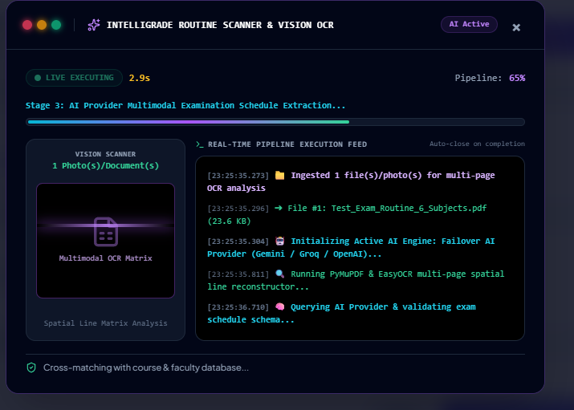
UI Demo: AI Exam Routine Scanning Modal
Exam Controller interface for uploading institutional schedule PDFs for automatic parsing

Slide 58
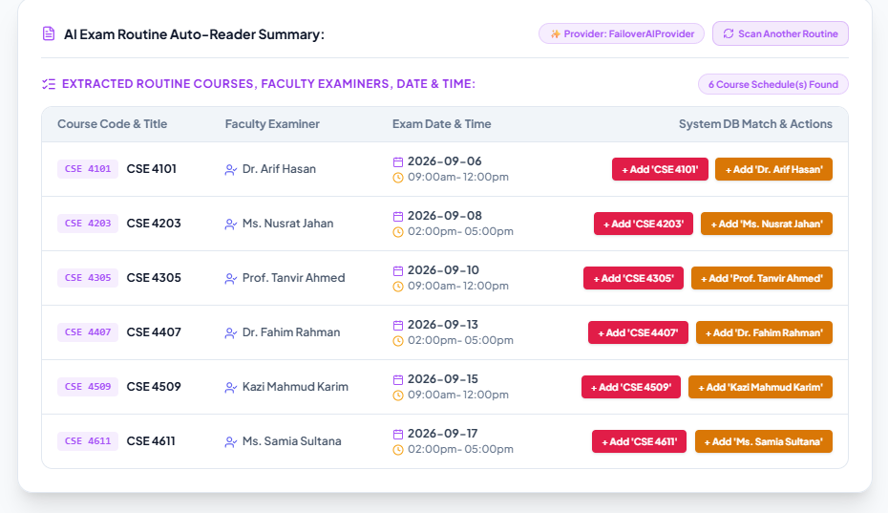
UI Demo: Parsed Examination Schedule & Courses
Extracted exam timetable, course codes, exam dates, and slot allocations ready for approval

Slide 59
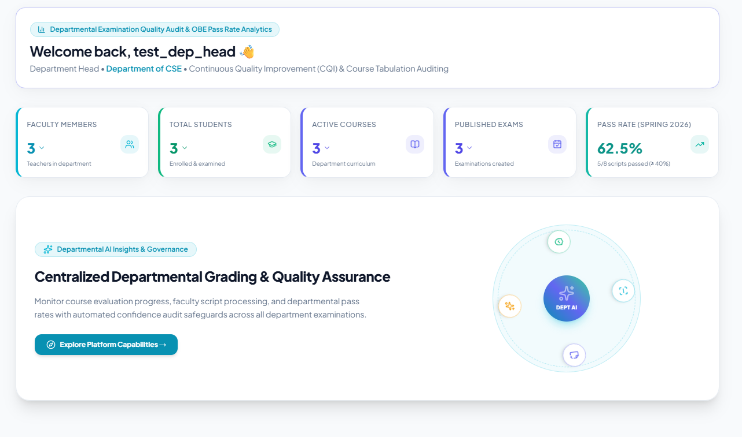
UI Demo: Department Head Governance Dashboard
Executive dashboard tracking faculty grading velocity, submission volumes, and course metrics

Slide 60
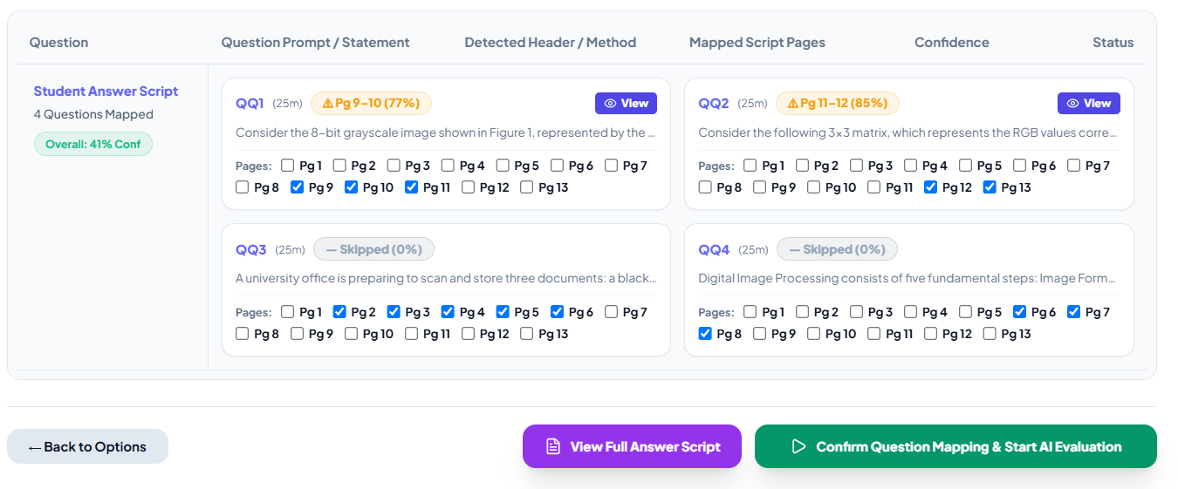
UI Demo: Question & Rubric Authoring Studio
23-field taxonomy authoring interface linking Bloom's taxonomy, COs, and evaluation rubrics

Slide 61
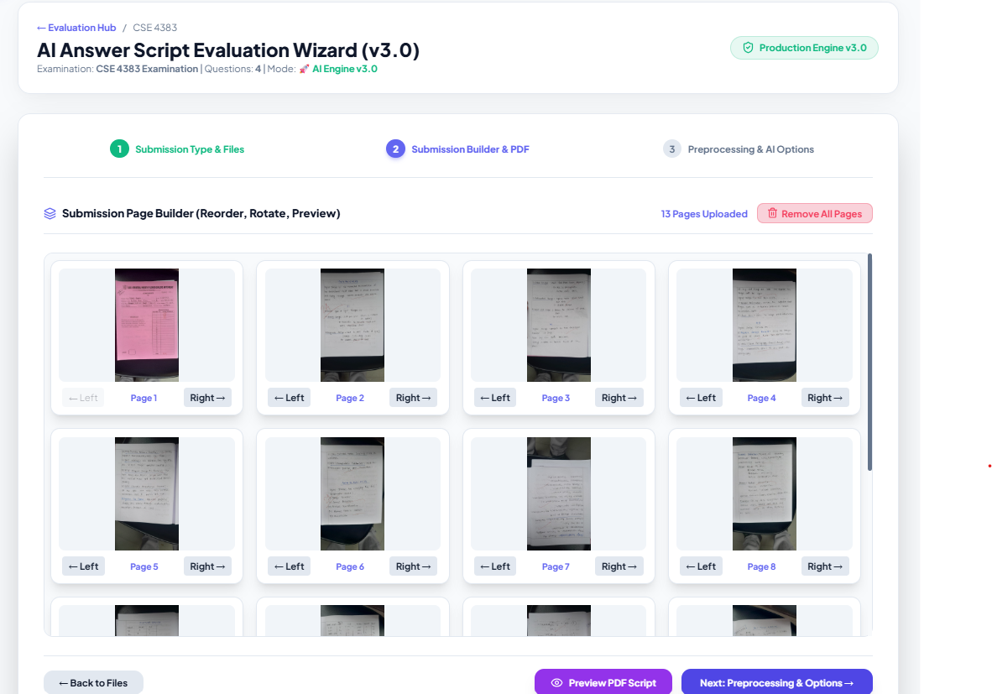
UI Demo: Answer Script Ingestion & Slicing Modal
Batch upload modal rasterizing multi-page student scripts into 300 DPI working copies

Slide 62
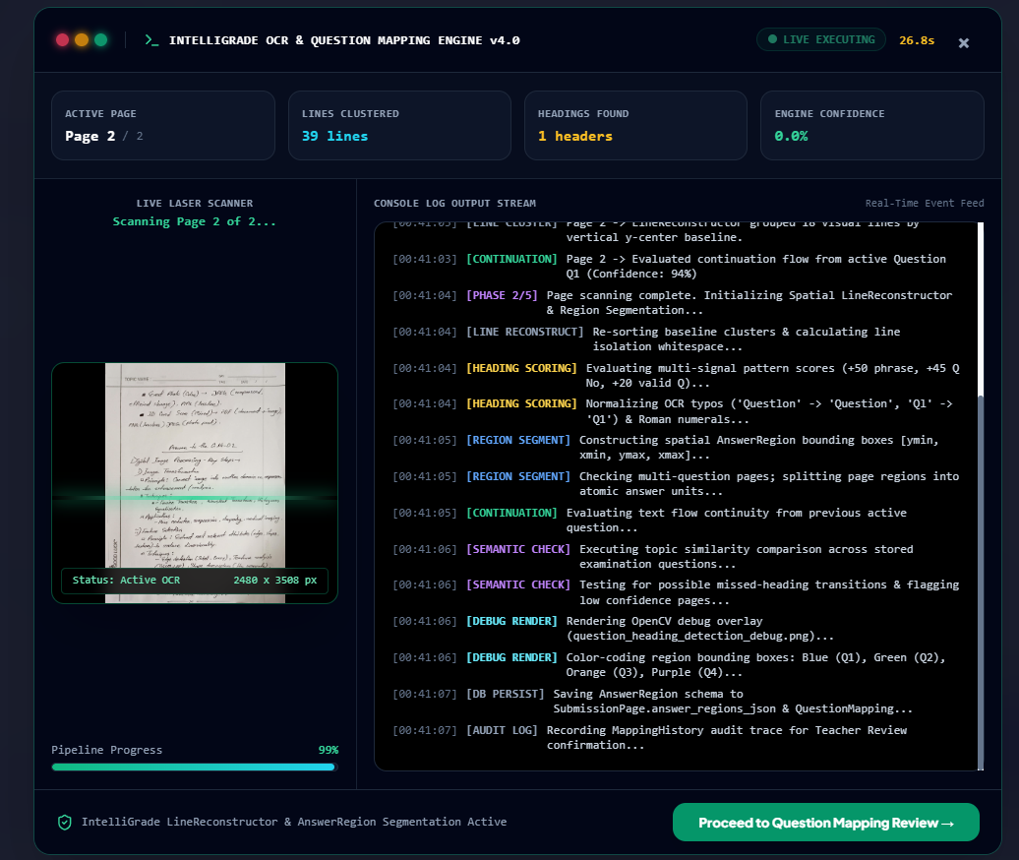
UI Demo: OCR Question Boundary Mapping View
OpenCV & OCR pipeline matching student handwritten answer regions to exam questions

Slide 63
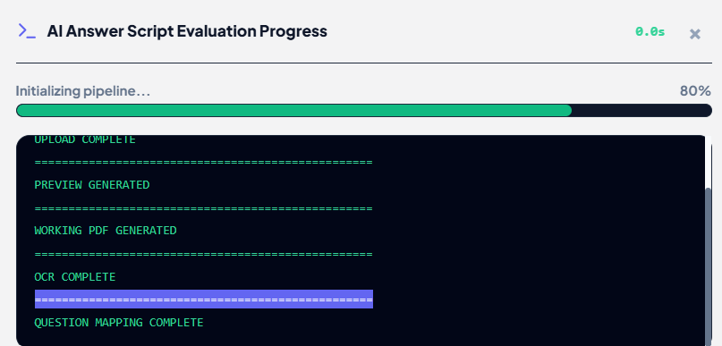
UI Demo: Multi-Provider AI Evaluation Progress
Live task runner tracking AI evaluation queue and provider health fallback status

Slide 64
Split-Screen Teacher Grading Workbench
Side-by-side: scanned script image (left) vs rubric criteria + AI score (right)
[ Screenshot: /teacher/submission/{id}/workspace/ ]
Figure 12: Split-Screen Teacher Grading Workbench — Scanned script image with pan/zoom/rotate (left) vs Question prompt, Rubric checklist, AI confidence score, and mark override controls (right)
→ Highlight: AI score panel, rubric criteria, confidence badge, override controls
Slide 34/37

Slide 65
OBE Course Tabulation & 8-Sheet Excel Export
Real-time aggregation: CT 10% + Mid 25% + Final 50% + Assign 10% + Att 5%
[ Screenshot: /teacher/exam/{id}/course-tabulation/ ]
Figure 13: OBE Course Tabulation — Real-time grade aggregation (CT 10% + Mid 25% + Final 50% + Assign 10% + Att 5%), CO/PO attainment matrix, and 8-Sheet openpyxl Excel export
→ Highlight: Grade table, CO/PO attainment matrix, 8-sheet Excel download button
Slide 35/37

Slide 66
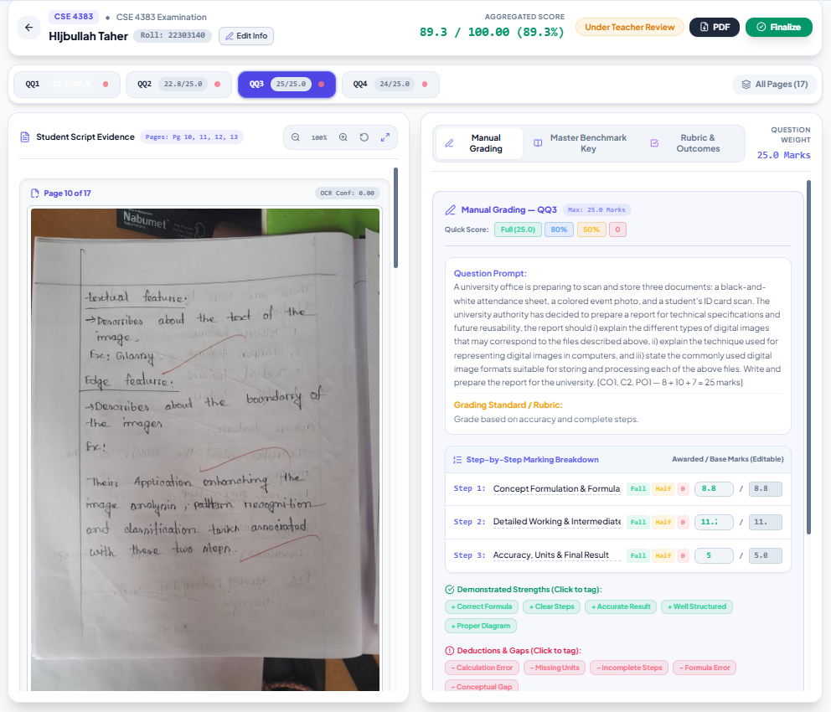
UI Demo: Fast Manual Script Grading Wizard
Alternative streamlined grading workflow enabling rapid manual score entry and annotation

Slide 67
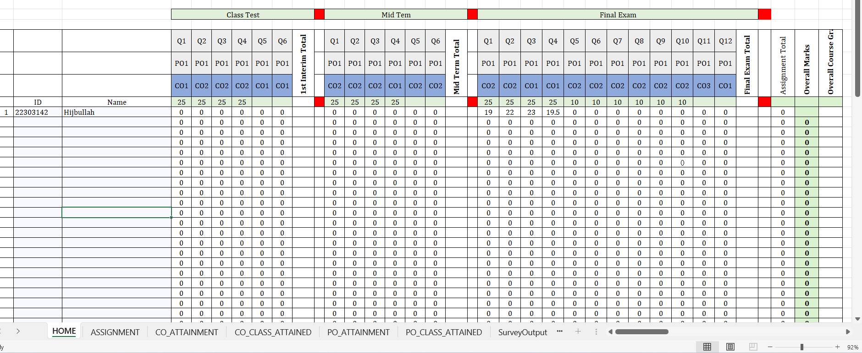
UI Demo: Generated 8-Sheet Official Excel Export
Official openpyxl Excel workbook formatted strictly according to BAETE accreditation guidelines

Slide 68
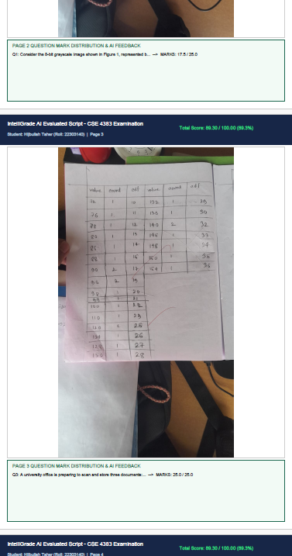
UI Demo: Watermarked Evaluated Certified PDF
Digitally stamped student answer script containing official seals and question-by-question marks

Slide 69
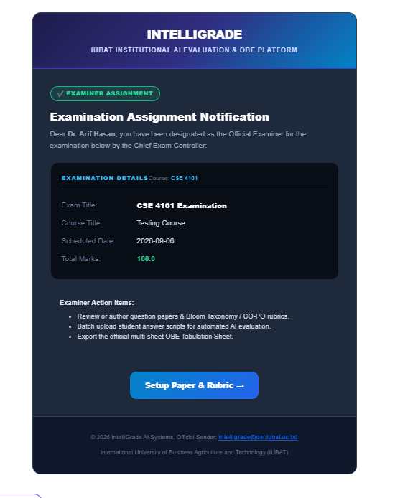
UI Demo: Automated Email Notification Dispatch
System-generated HTML email alerts notifying faculty of grading assignments and deadlines

Slide 70
Student Transparency Portal — Academic Dashboard
Students view overall GPA, question-wise marks, CO/PO attainment, certified PDF
[ Screenshot: /dashboard/student/ ]
Figure 14: Student Transparency Portal — 4.00-scale GPA summary card, course-wise mark breakdown, question-level AI feedback, CO/PO attainment, and certified watermarked PDF download
→ Highlight: GPA card, course breakdown, question feedback, PDF download link
Slide 36/37

Slide 71
High-DPI Server Storage Consumption
Uncompressed 300 DPI rasterized scripts demand considerable local storage before finalization purge triggers.
Cursive Handwriting OCR Ambiguity
Extremely degraded, low-contrast, or unreadable student handwriting requires human examiner intervention.
Browser Memory Utilization
Rendering dozens of high-resolution canvas overlays in split-screen mode requires modern client browser hardware.
System Limitations & Operational Boundaries
Cloud AI API Throttling & Latency
Reliance on external free-tier AI APIs (Groq, Gemini) can encounter sudden rate limits under concurrent exam surges.

Slide 72
Dedicated Edge GPU Inference
Deploying on-premises NVIDIA RTX GPUs to accelerate EasyOCR and Moondream2 evaluation by over 100x.
RAG-Powered Marking Consistency
Integrating pgvector vector databases to calibrate AI scoring against historical teacher marking styles.
Native Mobile Examination Portal
Developing cross-platform Flutter mobile applications for instant student grade alerts and offline script review.
Future Roadmap & Engineering Directions
Asynchronous Distributed Task Workers
Migrating heavy OCR and AI evaluation tasks to Celery workers backed by Redis message queues.

Slide 73
Conclusion & Future Work
Key Project Achievements
Future Research & Scaling
✓ 21 functional modules fully implemented and verified
▸ Celery + Redis: Async distributed OCR/AI workers
✓ 27 use cases covered — 0 open critical issues
▸ GPU CUDA inference: 104x faster EasyOCR evaluation
✓ 37 Functional + 17 Non-Functional Requirements satisfied
▸ INT8 Quantized Moondream: on-device 0.3s/page
✓ 479 UFP / 536.48 AFP — large-scale enterprise system
▸ Token bucket rate limiter: eliminate 429 stalls
✓ 47 unit + 28 integration + 15 UAT tests — 100% pass rate
▸ pgvector RAG: historical mark calibration per teacher
✓ 5-provider AI failover, 23-taxonomy OBE, 8-sheet Excel, certified PDF
▸ Mobile app: student script viewing on Android/iOS
Academic References & Standards
[1] Django Documentation v5.2 — djangoproject.com
[5] Albrecht, A.J. (1979). Measuring Application Development Productivity. IBM
[2] IUBAT OBE Academic Policy & Examination Regulations
[6] EasyOCR — Jaided AI (2021). github.com/JaidedAI/EasyOCR
[3] BAETE Accreditation Manual for Engineering Programs
[7] Google Gemini API Documentation — ai.google.dev
[4] IFPUG Function Point Counting Practices Manual v4.3.1
Thank You | Questions Welcome

Slide 74
References
List here the reference list by following the Harvard referencing format (Remove this line)
Nasir, A.Y., Bature, U.I., Tahir, N.M., Babawuro, A.Y., Boniface, A. and Hassan, A.M., 2020. Arduino based gas leakage control and temperature monitoring system. International Journal of Information and Communication Technology (IJ-ICT), 9(3), pp.171-178.
Qasim, H.H., Hamza, A.E., Ibrahim, H.H., Saeed, H.A. and Hamzah, M.I., 2020. Design and implementation home security system and monitoring by using wireless sensor networks WSN/internet of things IOT. International Journal of Electrical and Computer Engineering, 10(3), p.2617.
Saxena, A. and Pal, R., 2020. IoT Based Security and Controlled Smart Home Automation System Using GSM. International Journal of Research in Engineering, Science and Management, 3(8), pp.445-448.
NOTE: Please consult with your supervisor before and after preparing the Practicum Final Defense presentation slides
Place Thesis Title Here
74

Slide 75
Any Questions ?

Slide 76
Thank You

